Slide 1
PUNCTUATING AND CAPITALIZING TITLES

Slide 2
TO DETERMINE HOW TO PUNCTUATE A TITLE, YOU FIRST NEED TO DETERMINE IF IT IS CONSIDERED A BIG PIECE OF WORK OR A SMALL PIECE OF WORK
BIG THINGS
“SMALL THINGS”
BOOK
MAGAZINE
CD TITLE
MOVIE
PLAY
BOOK CHAPTER
MAGAZINE ARTICLE
SONG
SHORT STORY
POEM
Small things are normally read or viewed in ONE sitting -- less than an hour.

Slide 3
LITTLE TITLES (Things read / viewed in ONE sitting)
SHORT STORIES, CHAPTER TITLES, NEWSPAPER ARTICLES, POEMS, SONGS
THINGS THAT NORMALLY CAN BE READ IN ONE SITTING
GO IN “ ” Quotation Marks

Slide 4
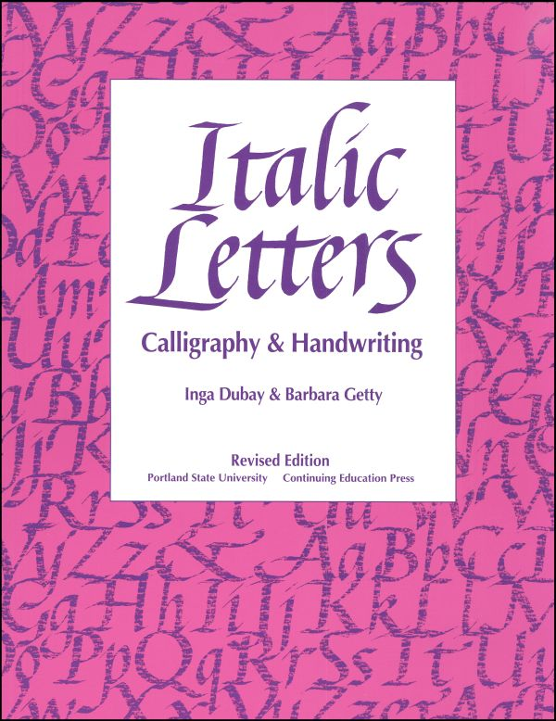
BIG THINGS
(Things that take over 45 min to view or read)
NEWSPAPERS, BOOKS, MOVIES, CD TITLE, MAGAZINES
ARE UNDERLINED OR IN ITALICS

Slide 5
CAPITALIZING TITLES
FIRST, LAST, AND ALL IMPORTANT WORDS OF A TITLE ARE ALWAYS CAPITALIZED

Slide 6
YOU DO NOT PUNCTUATE YOUR OWN TITLE WHEN IT APPEARS WITH THE ACTUAL WORK ITSELF (AT THE TOP OF YOUR PAPER)

Slide 7
CHECK FOR UNDERSTANDING:
HOW WOULD YOU PUNCTUATE AN ARTICLE IN A NEWSPAPER OR A SHORT STORY?
A) QUOTATION MARKS
Or
B) ITALICS or UNDERLINING
Notes:
🍐 This is a Pear Deck Multiple Choice Slide. Your current options are: A: quotation marks, B: underlined OR in italics,
🍐 To edit the type of question or choices, go back to the "Ask Students a Question" in the Pear Deck sidebar.

Slide 9
It’s your choice whether you want to use underlining OR italics for larger works like books or movies since underlining and italics are interchangeable .
True
False
Notes:
True or False
Use this template to do a quick check of students’ perceptions during your lesson.
🍐 This is a Pear Deck Multiple Choice Slide. Your current options are: A: True, B: False,
🍐 To edit the type of question or choices, go back to the "Ask Students a Question" in the Pear Deck sidebar.

Slide 11
CHECK FOR UNDERSTANDING
HOW WOULD YOU PUNCTUATE A SONG OR A POEM?
A) QUOTATION MARKS
Or
B) ITALICS or UNDERLINING
Notes:
🍐 This is a Pear Deck Multiple Choice Slide. Your current options are: A: quotation marks, B: underlined or in italics,
🍐 To edit the type of question or choices, go back to the "Ask Students a Question" in the Pear Deck sidebar.

Slide 12
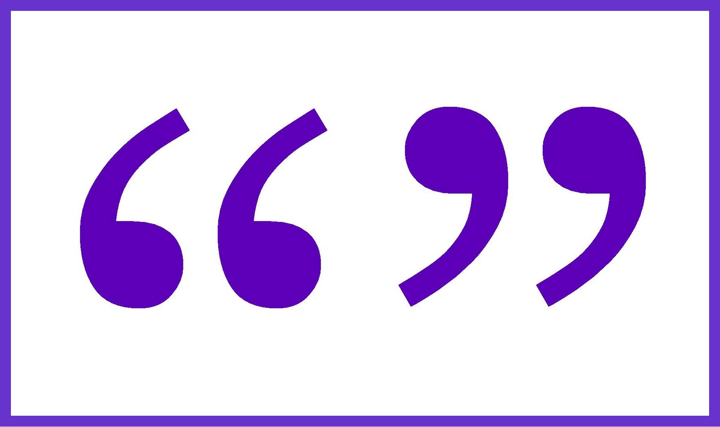
ANSWER SONGS GO IN QUOTATION MARKS

Slide 13
CHECK FOR UNDERSTANDING
HOW WOULD YOU PUNCTUATE A BOOK OR A MOVIE?
A) QUOTATION MARKS
Or
B) ITALICS or UNDERLINING
Notes:
🍐 This is a Pear Deck Multiple Choice Slide. Your current options are: A: quotation marks, B: underlined or in italics,
🍐 To edit the type of question or choices, go back to the "Ask Students a Question" in the Pear Deck sidebar.

Slide 14
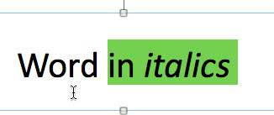
OR

Slide 15
NEED MORE ONLINE REVIEW?
CLICK HERE
TO ACCESS MORE REVIEW ON THIS CONCEPT

